Slide 1



Auraluxe: A Single Vendor E commerce Application for Luxury Building Materials
IUBAT–INTERNATIONAL UNIVERSITY OF BUSINESS AGRICULTURE AND TECHNOLOGY
Founded 1991 by Md. Alimullah Miyan
Practicum Defense
Prepared for:
Practicum Defense Committee
Department of Computer Science and Engineering
Prepared by:
Md. Moniruzzaman
ID: 22103018
Supervised by:
Dipta Mohon Das
Lecturer
Date: 25/01/2025

Slide 2
Table of contents
Organization Overview
Project Introduction
Objectives of this Project
Process Model
Feasibility Study
Requirement Engineering
Use Case Diagram
Software Analysis Pattern
Activity Diagrams
Swim-lane Diagrams
Sequence Diagrams
Class Diagram
02

Slide 3
Table of contents (Cont.)
Risk Management
Function Point Analysis
Task Scheduling
Data Flow Diagram
ER Diagram
System Quality Assurance
System Testing
Ethical Considerations
Project Demonstration
Limitation of The Project
Conclusion & Future Scope
03

Slide 4
Organization Overview
ATI Limited (Advanced Technology & Innovation)
Nature: Software development and e-commerce technology company.
Services:
  Custom Software Development
  E-commerce Platform Development
  Web & Mobile Application Development
Vision: To be a recognized technology provider supporting business growth through reliable and innovative software solutions.
Mission: Delivering tailored software solutions and developing new talent through mentorship.
My Role: Jr. Frontend Developer.
04

Slide 5
Project Introduction
Problem Statement:
  Traditional showroom-based sales limit customer reach.
  Lack of detailed product information online.
  Time-consuming product discovery process.
Solution - "Auraluxe" :
A single-vendor e-commerce platform for premium imported building materials and interior solutions with:
  Detailed product catalogs with specifications and pricing.
  Project portfolio showcase for inspiration.
  Secure online ordering and payment.
Technology:
  Next.js, TypeScript, NestJS, PostgreSQL, Prisma ORM, SSLCommerz
05

Slide 6
Objectives of this Project
Broad Objective:
  Design and develop a scalable, secure e-commerce platform for premium building materials with seamless product management and online transactions.
Specific Objectives:
  Architecture: Implement Clean Architecture using Next.js and NestJS for maintainability.
  Product Management: Develop comprehensive CRUD operations for products, categories, and brands.
  Shopping Experience: Create intuitive product browsing, filtering, and cart management system.
  Payment Integration: Integrate SSLCommerz for secure online transactions.
  Content Management: Build admin dashboard for managing products, orders, and project portfolios.
  Security: Ensure data privacy with Role-Based Access Control (RBAC) and secure authentication.
06

Slide 7
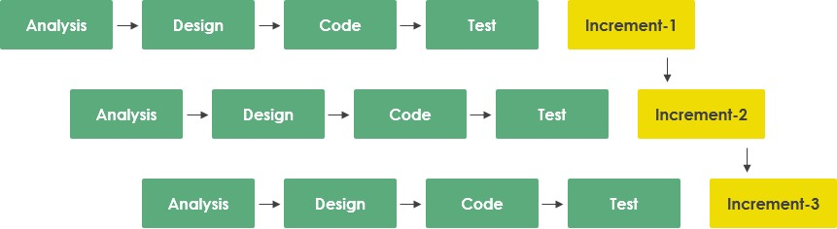
Process Model
Model Selected: Incremental Process Model.
Justification:
  Validated authentication and product catalog (Increment 1) before cart and payment features.
  Allowed incorporation of stakeholder feedback between increments.
  Enabled distinct focus on Authentication, Product Management, Shopping Cart, and Payment modules.
  Early testing of critical modules reduced integration issues.
07

Slide 8
Feasibility Study
Feasibility study means checking if a project is possible to build and useful before starting it.
Technical Feasibility:
  Leveraged robust Next.js and NestJS ecosystems.
  Utilized Prisma ORM for efficient database operations.
  Integrated standard RESTful APIs for SSLCommerz payment gateway.
Economic Feasibility:
  Low upfront cost using open-source frameworks (Next.js, NestJS, PostgreSQL).
  Free-tier services for development and testing.
Operational Feasibility:
  Self-sustaining workflows (automated order processing and inventory management).
  Admin dashboard reduces manual intervention.
08

Slide 9
Requirement Engineering
Requirement Engineering is the process of understanding what the user wants from the system.
Requirements categorized into:
  User Requirements
  System Requirements
  Functional Requirements
  Non-Functional Requirements
09

Slide 10
User Requirements
Customer (User):
Account & Security : Secure email/password authentication with email verification.
Product Discovery: Browse products with filtering by category, brand.
Booking Shopping Experience: Add products to cart with quantity management.
Payments & Feedback: Secure SSLCommerz integration .
10

Slide 11
User Requirements (Cont.)
Administrator:
Product Management: Create, update, delete products with images, specifications, categories, and brands.
Order Management: View, process customer orders, and update order status and inventory.
Content Management: Manage home banners, featured sections, and project portfolios.
Platform Governance: User management, role-based access control, and platform analytics monitoring.
11

Slide 12
System Requirements
Platform Constraints
  Architecture: Full-stack web application with Next.js frontend and NestJS backend (Clean Architecture).
  Database: PostgreSQL managed via Prisma ORM for type-safe database operations.
External Integrations
  Payment Gateway: Secure integration with SSLCommerz for online transactions.Image
  Storage: Cloud-based image storage for product and project images.
System Capabilities
  Data Management: Efficient storage and retrieval of products, categories, brands, orders, and user data.
  Real-time Operations: Dynamic cart updates, inventory tracking, and order status management.
13

Slide 13
Functional Requirements
Core Modules:
  Authentication: User registration with email verification and secure login system.
  Product Management: Admin can Create, Read, Update, and Delete products with images and specifications.
Order Lifecycle:
  Shopping Flow: Browse Products → Add to Cart → Checkout → Payment → Order Confirmation.
  Inventory Control: Real-time stock validation to prevent overselling.
Admin Functions:
  Product & Category Management: Manage products, categories, brands, and brand types.
  Order Management: View, process, and update order status.
  Content Management: Manage home banners, featured products, and project portfolios.
14

Slide 14
Functional Requirements(cont.)
Data Integrity :
  Stock Management: Automated inventory updates after successful orders.

Slide 15
Non-Functional Requirements
Security:
  Data Protection: Strong password hashing (bcrypt) and HTTPS encryption for all data.
  Access Control: Role-Based Access Control (RBAC) ensuring user and admin data isolation.
Performance:
  Query Optimization: Efficient database queries using Prisma ORM for fast product retrieval.
  Responsive UI: Server-side rendering with Next.js for optimal page load times.
Reliability & Scalability:
  Data Integrity: PostgreSQL transactions ensure consistent order and payment processing.
  Modular Architecture: Clean Architecture pattern supports future scaling and maintenance.
15

Slide 16
Non-Functional Requirements(cont.)
Usability :
  User Experience: Intuitive navigation with clear feedback (success/error notifications).

Slide 17
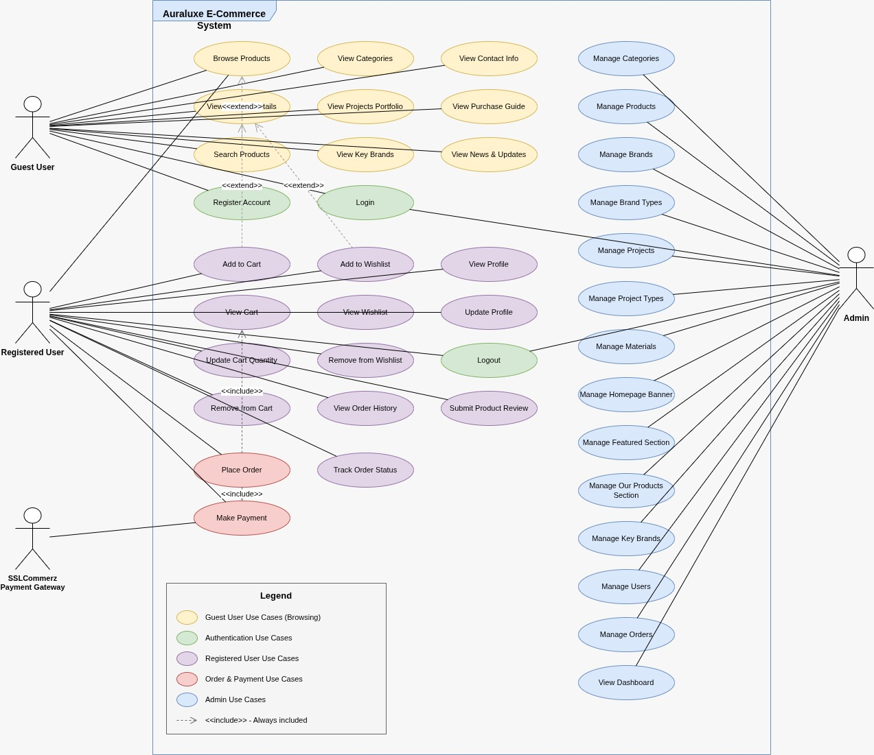
Use Case Diagram
Actors & Key Use Cases:
Customer: Login/Registration, Manage Profile, Browse products, View product detail , Add product to cart , Checkot product , Make Payment , View Project Portfolio
Admin: Manage Products & Inventory, Manage Projects & Materials, Process Orders, Update Homepage Banners, View Sales Dashboard, Manage Users.
16

Slide 18
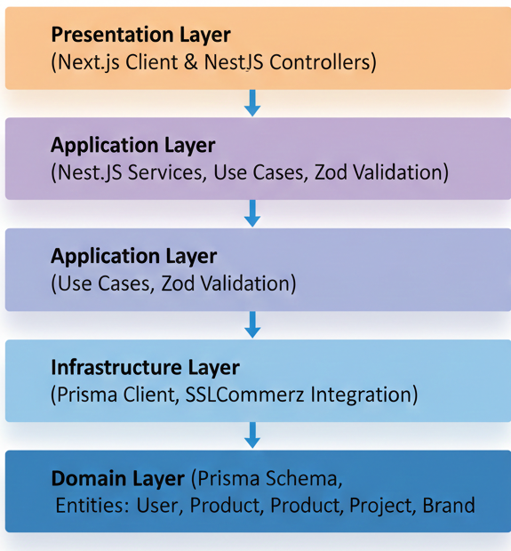
Software Analysis Pattern
Architecture: Clean Architecture (Onion Architecture).
Structure:
  Presentation Layer: Next.js Client for UI & NestJS Controllers for handling API requests.
  Application Layer: Contains business logic, NestJS Services, Use Cases, and Zod Validation.
  Infrastructure Layer: Manages data access via Prisma Client and external integrations like SSLCommerz.
  Domain Layer: Defines core entities (User, Product, Project, Brand) and the Prisma Schema.
Benefit: Ensures clear separation of concerns, improved scalability, and easier maintenance of the code base.
17

Slide 19
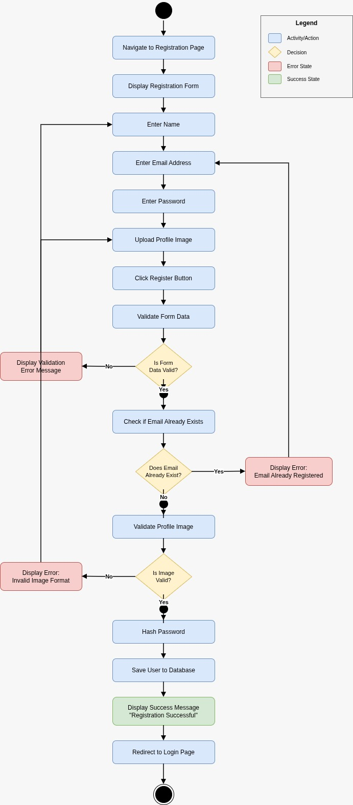
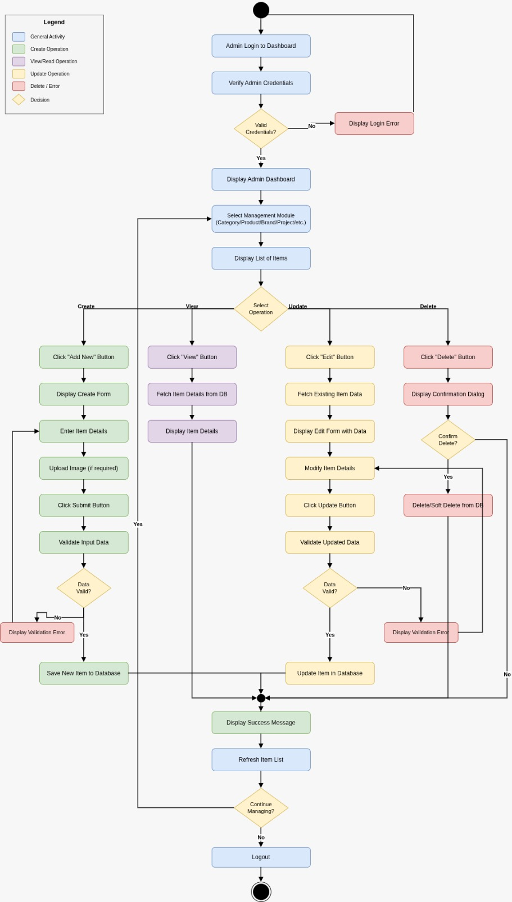
Activity Diagrams
Figure: User Registration
Figure: Admin Management Module
18

Slide 20
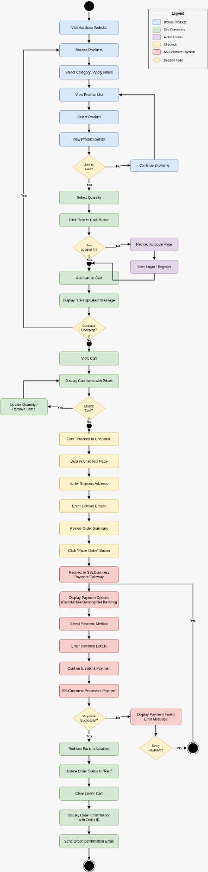
Activity Diagrams (Cont.)
Figure: Product Purchase Workflow
19

Slide 21
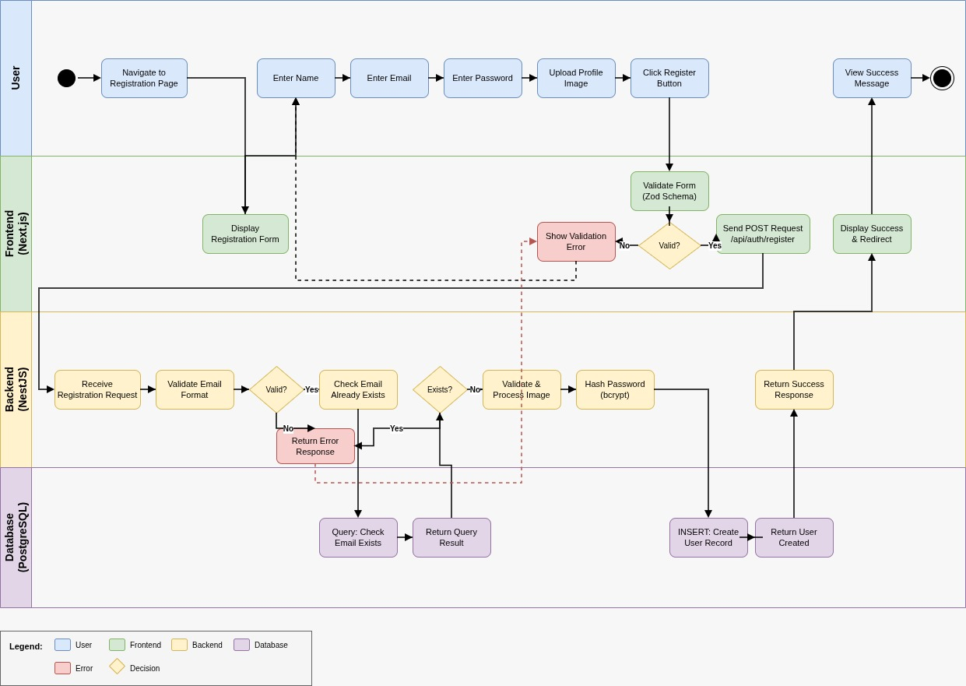
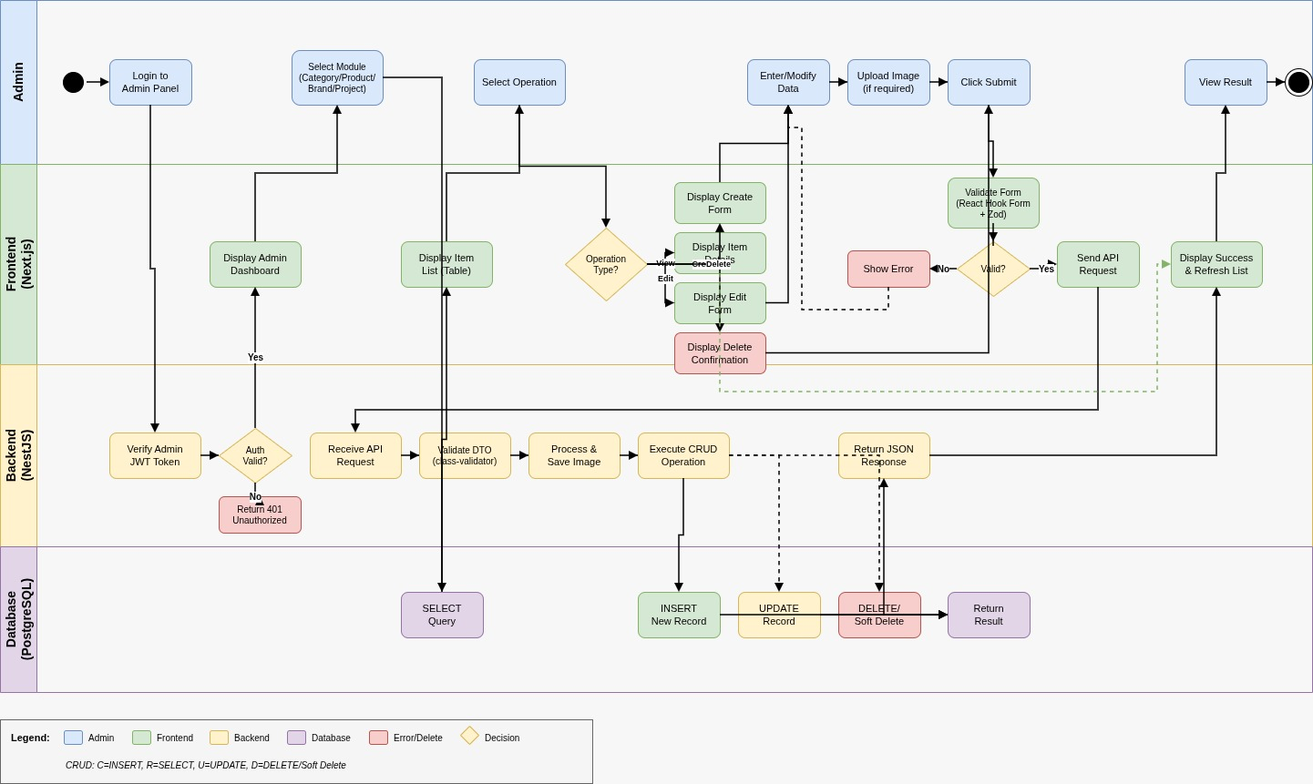
Swim-lane Diagrams
Figure: User Registration
Figure: Admin Management Module
21

Slide 22
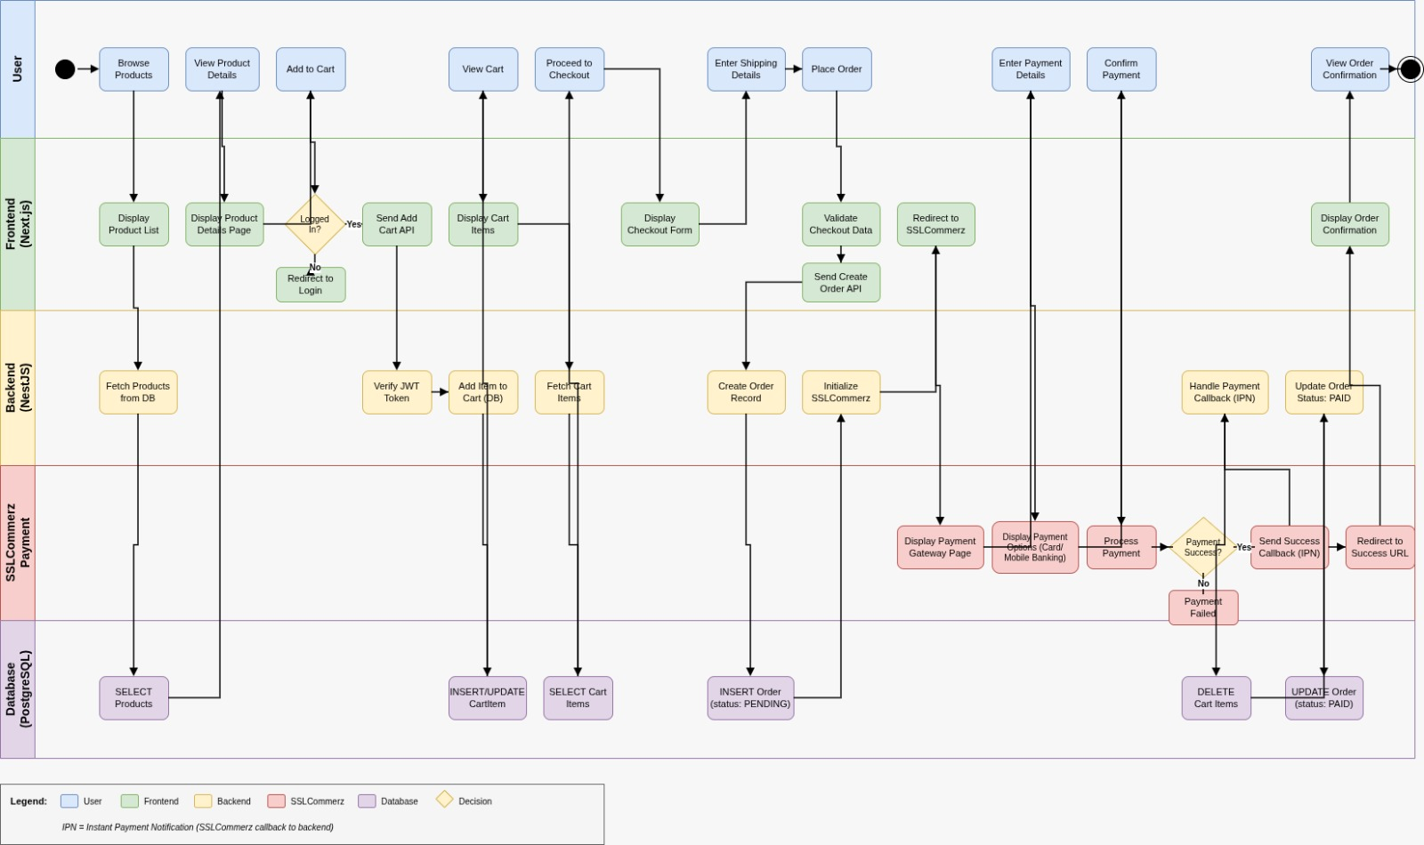
Swim-lane Diagrams (Cont.)
Figure: Product Purchase Workflow
22

Slide 23
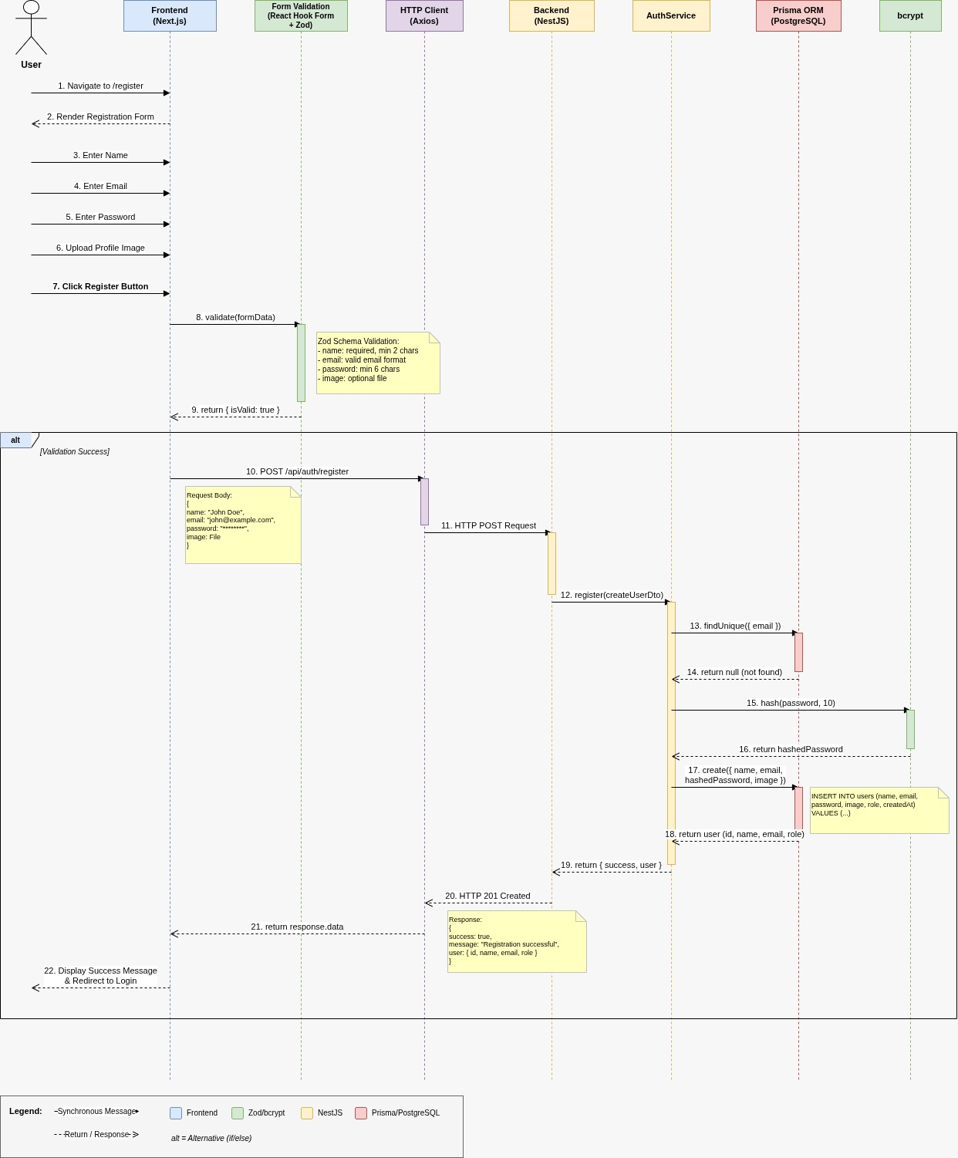
Sequence Diagrams
Figure: Registration
24

Slide 24
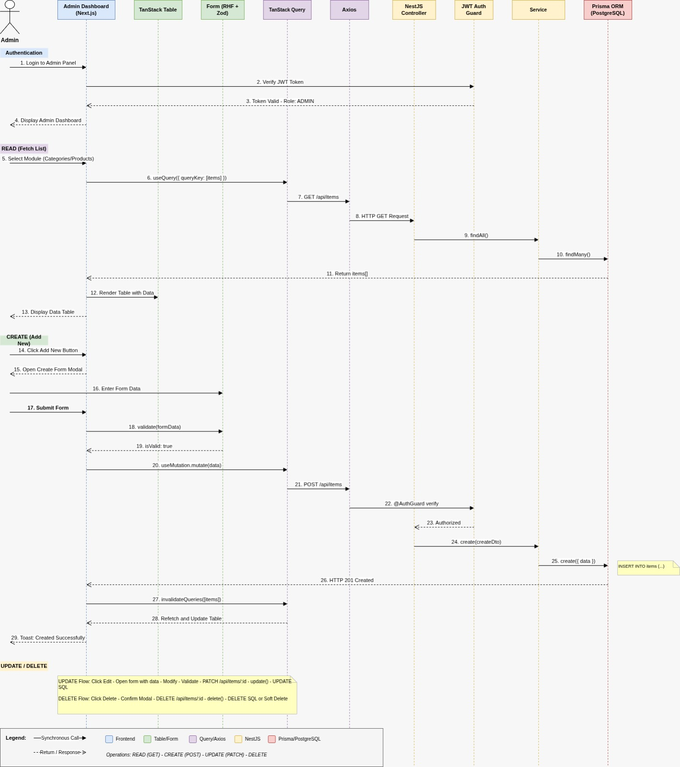
Sequence Diagrams (Cont.)
Figure: Admin Management Module
25

Slide 25
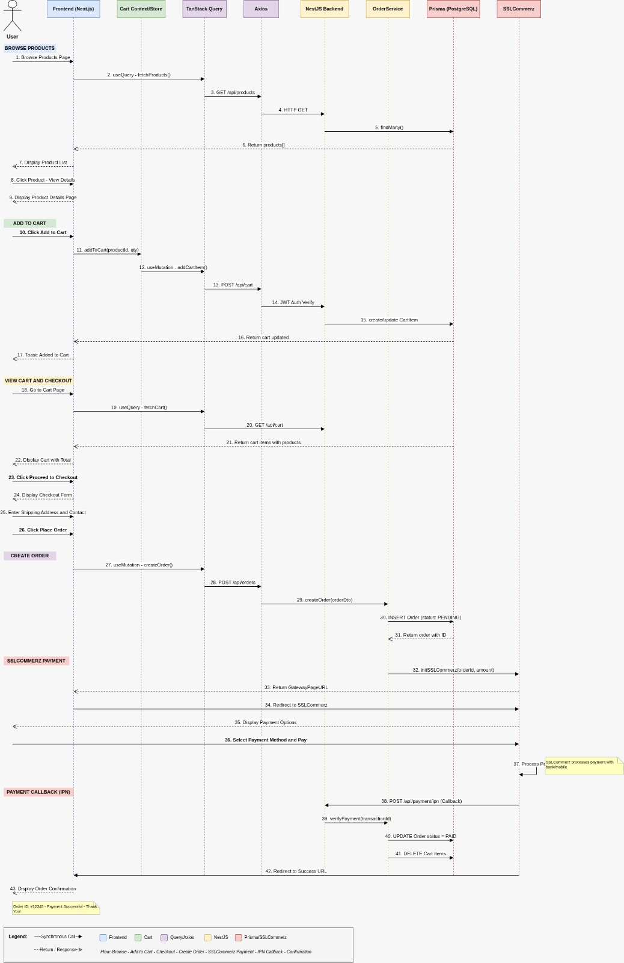
Sequence Diagrams (Cont.)
Figure: Product Purchase
26

Slide 26
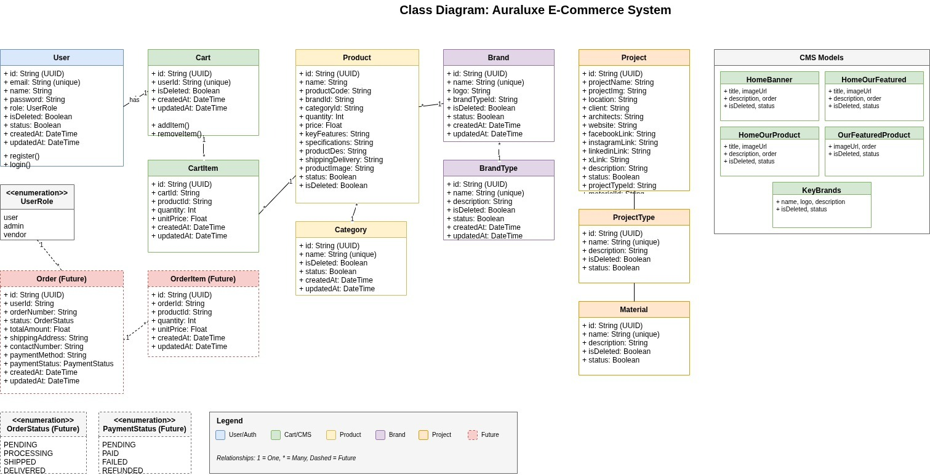
Class Diagram
Relationships:
User 1..1 Cart (One User has exactly one active Cart)
Category 1.. Product* (One Category contains many Products)
Brand 1.. Product* (One Brand manufactures many Products)
BrandType 1.. Brand* (One Brand Type categorizes multiple Brands)
Cart 1.. CartItem* (One Cart contains multiple Cart Items)
Figure: Class Diagram
27

Slide 27
Class Diagram(cont.)
Relationships:
Product 1.. CartItem* (One Product can be added to many Carts)
ProjectType 1.. Project* (One Project Type classifies multiple Projects)
Material 1.. Project* (One Material is used in multiple Projects)
User 1.. Order* (One User can place multiple Orders)
Figure: Class Diagram

Slide 28
Risk Management: Technical Risk
Technical Risk (R1) | Date:12-01-2026
Name | SSLCommerz Payment Gateway Failure
Impact | High (Payment functionality breaks, order completion halted)
Description | API downtime or integration errors preventing users from completing high-value transactions for premium building materials.
Mitigation & Monitoring | Implement Transaction Logging in the database (Payment model) to track all initiation attempts. Use try-catch blocks to handle API timeout errors gracefully.
Management | Display user-friendly error messages and provide offline order fallback.
Status | Mitigated (Fallback implemented)
28

Slide 29
Risk Management:Technical Risk
Technical Risk (R2) | Date: 12-01-2026
Name | Inventory Concurrency Issues
Impact | High (Overselling, negative inventory)
Description | Two users buying last unit simultaneously.
Mitigation & Monitoring | Use Prisma Transactions to lock database rows during checkout and monitor order vs stock deduction counts.
Management | Automatic transaction rollback on payment or stock update failure.
Status | Mitigated
29

Slide 30
Risk Management:Technical Risk
Technical Risk (R3) | Date: 12-01-2026
Name | Slow Page Load Times
Impact | Medium (Poor UX, high bounce rate)
Description | High-resolution images causing slow loads.
Mitigation & Monitoring | Use Next.js Image optimization, implement lazy loading, cache with TanStack Query, and run Lighthouse audits.
Management | Serve optimized images from CDN with progressive loading.
Status | Mitigated
30

Slide 31
Risk Management:Security Risk (R4)
Security Risk (R4) | Date: 12-01-2026
Name | Unauthorized Admin Access
Impact | Critical (Data manipulation)
Description | Unauthorized access to admin dashboard.
Mitigation & Monitoring | Enforce RBAC using JWT Guards, use bcrypt hashing, implement session timeouts, and log all failed login attempts.
Management | Immediate account lockout and automated security alerts.
Status | Mitigated

Slide 32
Function Point Analysis
Metrics: Measures software size based on functionality provided to the user.
Components:
  Internal Logical Files (ILF): Users, Products, Projects, Brands, Carts, Orders, Home Banners (High Complexity)
  External Interface Files (EIF): SSLCommerz Payment Gateway API
  Transactional Functions: Registration, Product Management, Cart Operations, Checkout, Payment Processing (EI/EO/EQ)
Calculation:
  Total Unadjusted Function Points (UFP) = 145
  Adjusted Function Points (AFP) = 157
Effort Estimation: ≈ 11.2 person-months
31

Slide 33
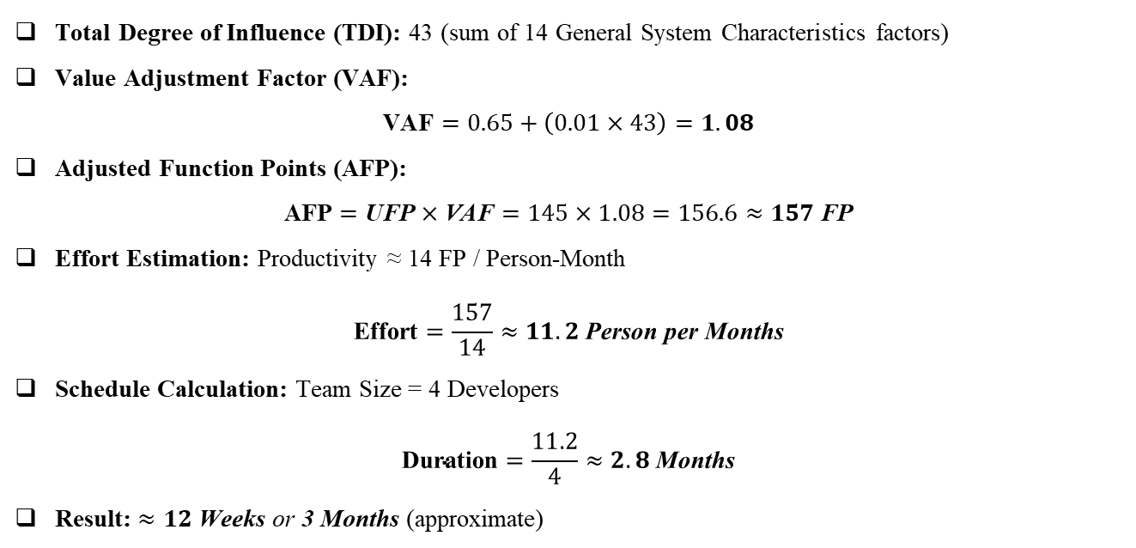
Function Point Calculation
Total Degree of Influence (TDI): 43 (sum of 14 General System Characteristics factors)
Value Adjustment Factor (VAF):
$$\text{VAF}=0.65+\left(0.01×43\right)=1.08$$
Adjusted Function Points (AFP):
$$\text{AFP}=\text{UFP}×\text{VAF}=145×1.08=156.6≈157 \text{FP}$$
Effort Estimation: Productivity ≈ 14 FP / Person-Month
$$\text{Effort}=\frac{157}{14}≈11.2 \text{Person} \text{per} \text{Months}$$
Schedule Calculation: Team Size = 4 Developers
$$\text{Duration}=\frac{11.2}{4}≈2.8 \text{Months}$$
Result: $≈12 \text{Weeks} \text{or} \text{3 }\text{Months}$ (approximate)
32

Slide 34
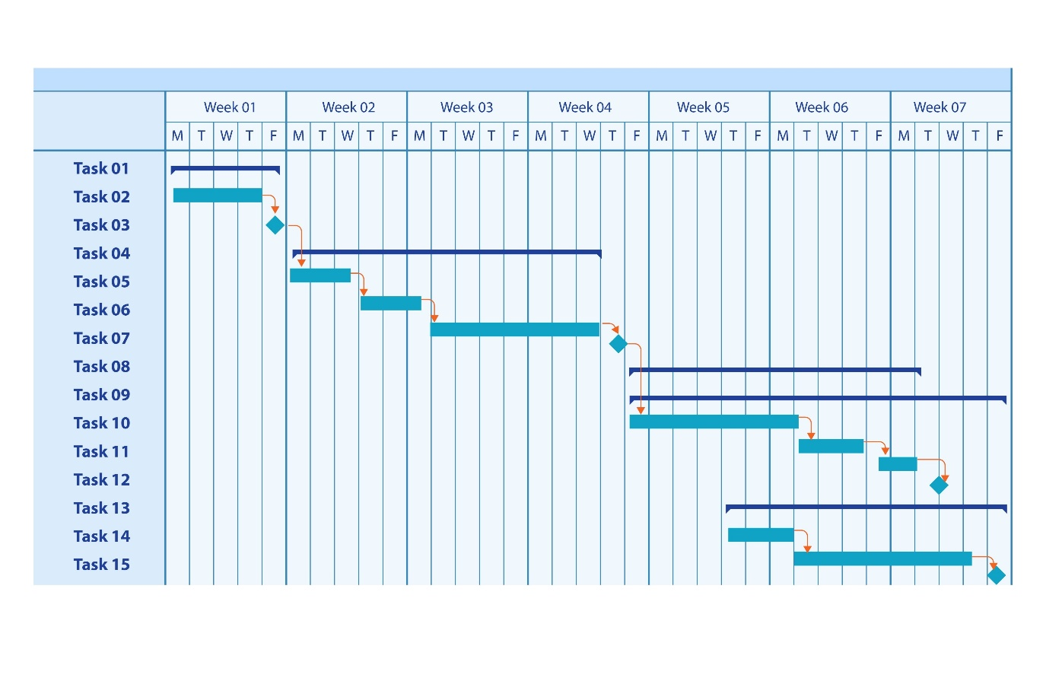
Task Scheduling
Project Timeline (12 Weeks: Oct 2025 – Jan 2026)
Planning & Design (4 weeks):Requirements, feasibility, tech stack selection (Next.js/NestJS), Architecture design, ERD, and UI/UX design.
Increment 1 (2 weeks): Authentication (User/Admin), Profile management, and CMS setup (Home Banners, Brand hierarchies).
Increment 2 (2 weeks):Product Catalog implementation, "Project Inspiration" showcase, and Search/Filter logic.
Increment 3 (2 weeks): Shopping Cart functionality, Order lifecycle, and Payment integration (SSLCommerz).
Figure: Project Schedule Gantt Chart
33

Slide 35
Task Scheduling(cont.)
Project Timeline (12 Weeks: Oct 2025 – Jan 2026)
Testing & Deployment (2 weeks): Unit/Integration testing, bug fixing, deployment to Vercel/VPS, and documentation.
Figure: Project Schedule Gantt Chart

Slide 36
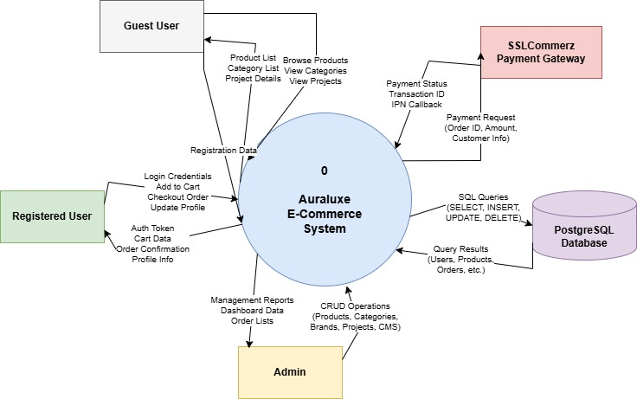
Data Flow Diagram
Level 0 (Context Level DFD):
Auraluxe System is the central processing unit.
Users register, browse luxury materials, and place orders.
Admin manages inventory, project portfolios, and monitors sales.
SSLCommerz handles secure payment transactions.
Figure:Level 0 DFD
34

Slide 37
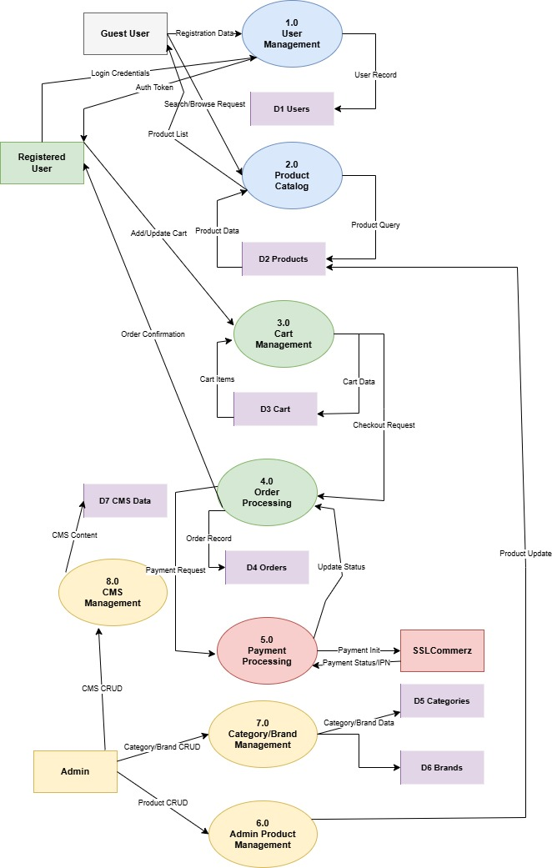
Data Flow Diagram (Cont.)
Level 1 DFD:
Manages user registration, secure login, and profile updates.
Handles product catalog retrieval, search, and filtering.
Processes shopping cart items and order creation.
Executes financial transactions via SSLCommerz.
Admin controls inventory, project portfolios, and CMS content.
Monitors sales data and updates order statuses.
Figure:Level 1 DFD
35

Slide 38
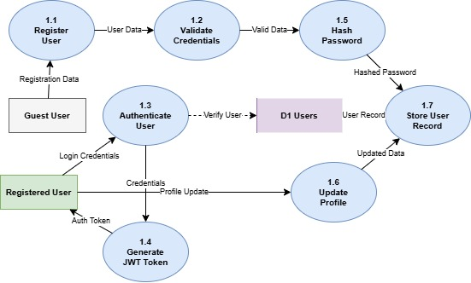
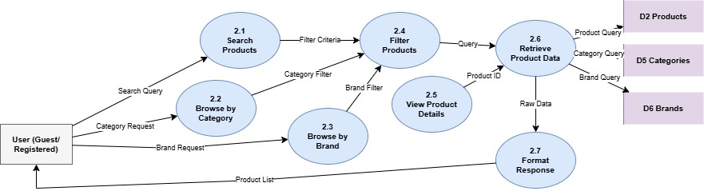
Data Flow Diagram (Cont.)
Level 1 DFD (process 1 & Process 2):
Figure: Process 1 – User Registration
Figure: Process 2 –Product Browsing
36

Slide 39
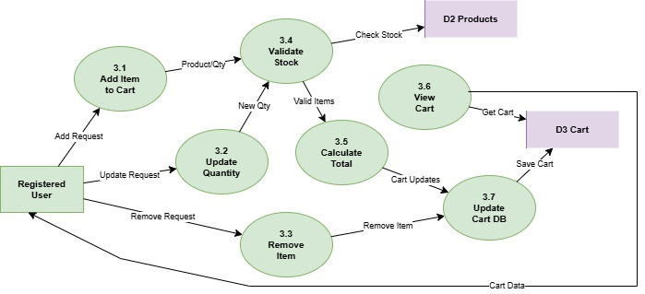
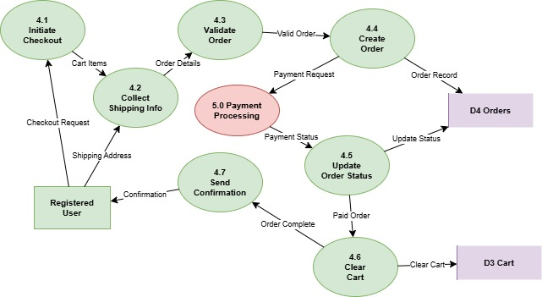
Data Flow Diagram (Cont.)
Level 1 DFD (Process 3 & Process 4):
Figure: Process 3 –Add to Cart
Figure: Process 4 –Order product
37

Slide 40
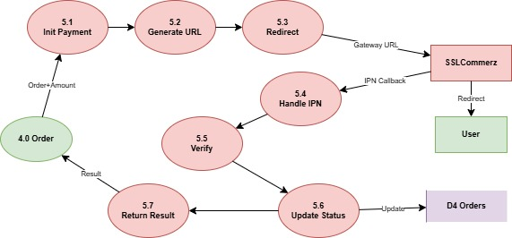
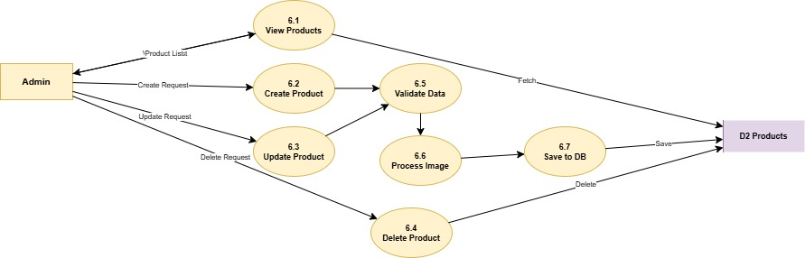
Data Flow Diagram (Cont.)
Level 1 DFD (process 5 & Process 6):
Figure: Process 5 –Payment Processing
Figure: Process 6 – Product Management
38

Slide 41
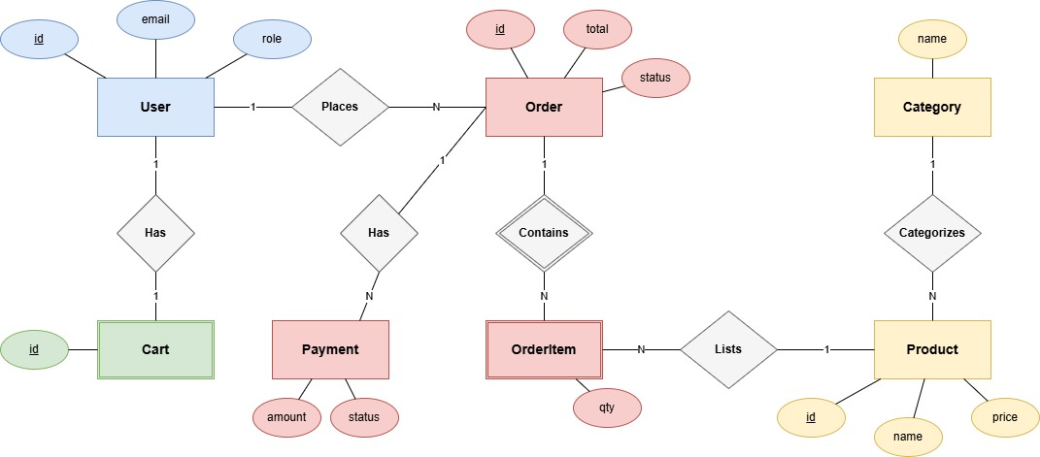
ER Diagram
User & Checkout Module:
User - Cart (1:1): Each user is assigned exactly one unique Shopping Cart to manage their temporary selections.
User - Order (1:N): A single user can place multiple Orders over time, creating a history of transactions.
Cart - CartItem (1:N): The Cart acts as a container that holds multiple Cart Items (products and quantities).
40

Slide 42
ER Diagram (Cont.)
Product Catalog Module:
BrandType - Brand (1:N): A broader "Type" (e.g., Ceramics) categorizes multiple specific Brands.
Brand - Product (1:N): Each Brand manufactures multiple unique Products.
Category - Product (1:N): Products are also organized by Category (e.g., Tiles, Faucets) for easy filtering.
41

Slide 43
ER Diagram (Cont.)
Order Processing Module:
Order - OrderItem (1:N): When an order is confirmed, it locks in multiple Order Items (preserving the price at the time of purchase).
Order - Payment (1:1): Each Order is linked to a single, distinct Payment record (containing the Transaction ID and Status).
42

Slide 44
ER Diagram (Cont.)
Project Inspiration Module:
ProjectType - Project (1:N): Projects are classified by their type (e.g., Residential vs. Commercial).
Material - Project (1:N): Specific Materials are linked to the Projects where they were utilized, allowing users to "Shop the Look."
43

Slide 45
System Quality Assurance
Quality Management Process
Design Validation: Ensured database schema (ER Diagram) and architecture (Clean Architecture) correctness before implementation.
Error Monitoring: Actively identified and fixed logic errors (payment failures, cart synchronization) during development.
Code Quality: Followed TypeScript standards, React best practices, and NestJS architectural patterns for clean, maintainable code.
Peer Reviews: Regular code reviews to catch logical errors and ensure consistency.
Performance: Tested page load times and API response times to meet performance benchmarks.
44

Slide 46
System Testing
Testing Scenario 1: User Registration
Scenario: | TC1: User registers with a valid email
Inputs: | Enter Name, Email, Password → Click Submit
Desired Output’s: | User account created, redirected to login page
Actual Output’s: | Database record inserted, user redirected successfully
Verdict: | Passed
45

Slide 47
System Testing (Cont.)
Testing Scenario 2: Product Browsing
Scenario: | TC4: User browses and filters products
Inputs: | Navigate to Products → Select Category (Tiles) → Apply Brand Filter
Desired Output’s: | Filtered products displayed.
Actual Output’s: | Product grid displays correctly with applied filters
Verdict: | Passed
46

Slide 48
System Testing (Cont.)
Testing Scenario 3: Processing payment for order
Scenario: | TC5: Processing payment for confirmed booking
Inputs: | Click “Checkout Button" → Enter SSLCommerz Sandbox Card Details → Submit
Desired Output’s: | Payment successful, validation ID stored, order status updates to "PAID"
Actual Output’s: | Transaction successful, validation ID stored in Payment table, order marked "PAID"
Verdict: | Passed
47

Slide 49
Ethical Considerations
Data Privacy:
Password encryption using bcrypt
HTTPS/TLS for data transmission
Minimal data collection for order fulfillment
Fairness:
Algorithm neutrality: Products ranked by relevance, not manipulation
Transparent pricing and accurate product information
Inclusivity:
Platform accessible to all users regardless of location or device
Payment Security:
SSLCommerz PCI-DSS compliance
No local storage of sensitive payment data
48

Slide 50
Project Demonstration
&
Question Answer Session
49

Slide 51
Limitation of the Project
Internet Dependency: Requires stable internet connection (no offline mode)
Payment Environment: Currently operates in SSLCommerz Sandbox mode
Mobile Features: Lacks native mobile app features (push notifications)
Real-time Support: No live chat for customer support
Single-Vendor Constraint: Designed for single vendor, not multi-vendor marketplace
50

Slide 52
Conclusion
Summary:
  Successfully developed Auraluxe, a functional, secure e-commerce platform for premium building materials with:
  Clean Architecture implementation
  SSLCommerz payment integration
  Robust product and order management
Future Scope:
  Native Mobile App: React Native for push notifications and offline features
  Real-Time Chat: WebSocket integration.
  Multi-Warehouse Support: Track inventory across multiple locations
  Advanced Features: AI product recommendations and dynamic shipping calculations
51

Slide 53
Thank You

